Slide 1
Concluding The Interview
Notes:
1

Slide 2
Miscellaneous Tax Forms Federal Section \ Miscellaneous Forms
Pub 4012 Tab N
Determine need for any miscellaneous tax forms
Injured Spouse Form (Form 8379)
Claim a Refund Due to a Deceased Taxpayer (Form 1310)
Application for Extension (Form 4868)
Married Filing Separately Allocations (Form 8958)
Installment Agreement (Form 9465)
Application for ITIN (Form W-7)
Find these forms in Federal section \ Miscellaneous Forms
Complete each as appropriate
Notes:
2

Slide 3
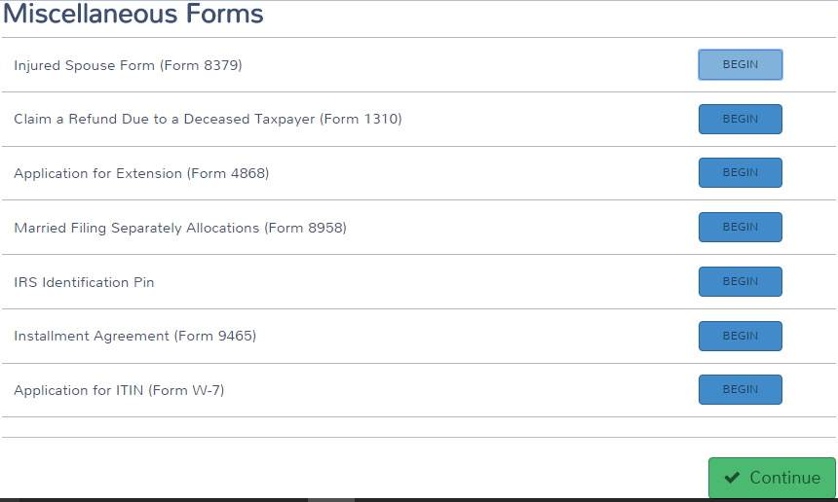
TS – Miscellaneous Forms
Pub 4012 Tab N
Notes:
3

Slide 4
Identity Theft
Pub 4012 Tab P
Identity Theft is the fraudulent acquisition of a person’s private identifying information, usually for financial gain
IRS sends notices to known taxpayer victims (or potential victims)
Letter includes 6-digit Identity Theft Protection PIN for filing return (reissued each year)
Counselor should routinely ask taxpayer about this
Enter in Federal section \ Miscellaneous Forms \ IRS Identification Pin

Slide 5
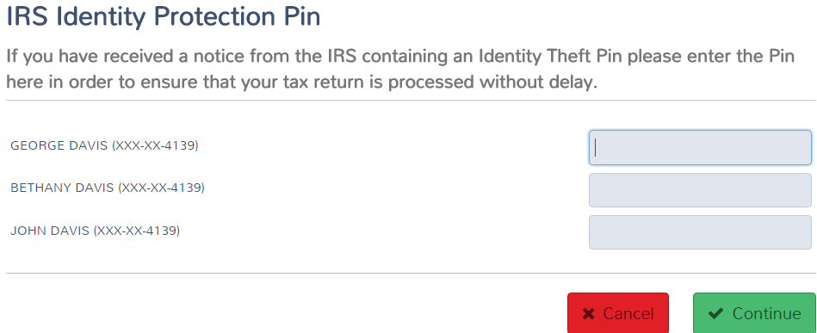
TS – IRS Identity Theft Pin Federal section \ Miscellaneous Forms \ IRS Identification Pin
Enter Identity Theft PIN next to appropriate name

Slide 6
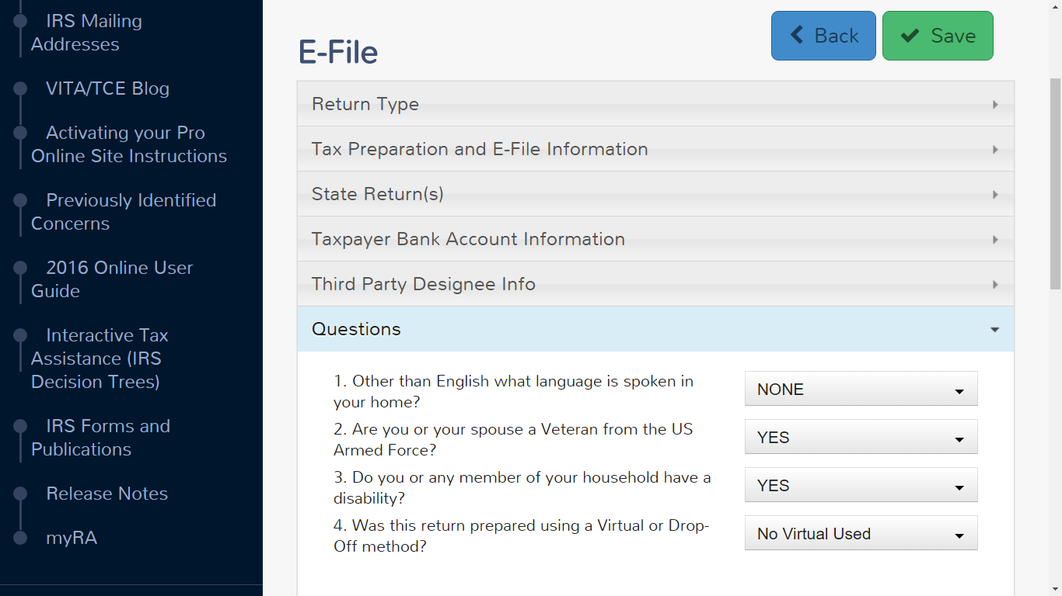
TS – Questions in E-File Section
Pub 4012 Tab N
Answer questions in E-File section
Language spoken in home
Veteran status
Disability status
Virtual or Drop-Off Method
Notes:
6

Slide 7
TS – Finalizing Return in TaxSlayer
Pub 4012 Tab N
(cont’d)
Print copy of return for taxpayer
Print from e-File section of return
Click on Print Return Button on Submission page
Print from Welcome page
Click on printer icon next to taxpayer’s name in Office Client list
Choose a print set from drop-down menu
Click Print Return
ERO will e-file returns & notify counselor of any rejects
Notes:
7

Slide 8
Finalizing Return with Taxpayer
Pub 4012 Tab K
Review printed return with taxpayer
Ask taxpayer to check spelling on names, SSNs, and address on top of 1040.
Review line by line Federal & NJ 1040s
Highlight any carry-overs or “issues”
Have taxpayer(s) sign Form 8879 IRS E-File Signature Authorization
Inform taxpayers they are responsible for return
If joint return, BOTH taxpayers MUST sign
Signatures acknowledge they know they are responsible for return and also gives permission to e-file
Assemble packet for taxpayer in envelope
Return all source documents, Intake/Interview sheet, signed 8879 – DO NOT KEEP ANY TAXPAYER DOCUMENTS
Notes:
Emphasize that there is a rule that we must inform taxpayers they are responsible for return
Read paragraph from 8879
8

Slide 9
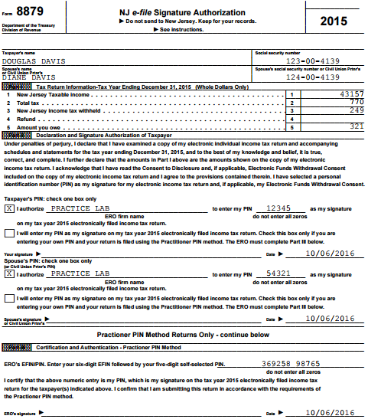
TS IRS e-file Signature Authorization - Form 8879
Inform taxpayer(s) they are responsible for return
and have them sign form
New signed 8879 required if changes to return result in change:
> $50 in Total Income or AGI
> $14 in Total Tax, Federal Income Tax Withheld or Amount You Owe
Any credit on return
Notes:
Taxpayer & Spouse must both sign Form 8879
Inform taxpayers they are responsible for accuracy of return
Not just signing to allow e-filing
Do not need to keep copy of 8879 or Federal copy of W-2s & 1099s to give to ERO
8879 is given back to taxpayer(s) in envelope
9

Slide 10
Power of Attorney (POA) – Form 2848
Pub 4012 Tab K
Required if someone other than taxpayer is signing return – gives authority for someone else to represent taxpayer with IRS
POA must include authority for income tax returns
Click on Your Office and then IRS Website. Search for Forms 2848 (POA) and 8453 (Transmittal Form to IRS)
On Form 2848:
Fill in info about taxpayer (Line 1) and representative (Line 2)
List Income Tax Return as Acts Authorized (Line 3)
Complete Line 6 if taxpayer had a previous POA
Both taxpayer and representative must sign and date
On Form 8453, “U.S. Individual Income Tax Transmittal for an IRS e-file Return,” check box to indicate that Form 2848 is being sent
POA is mailed to IRS along with Form 8453 transmittal form after e-file return is accepted
Notes:
Check the client’s Power of Attorney document to make sure it covers Tax Returns.
A “General Power of Attorney” permits the agent to conduct every kind of business or financial transaction.
A “Limited Power of Attorney” permits the agent to perform a specific act or acts
Also check the dates on the Power of Attorney are active.
10

Slide 11
Refunds/Balance Due
Pub 4012 Tabs 13 & 14
Discuss expected date/method of refund
Review payment alternatives if balance due
Can e-file now & pay by 4/18 with payment voucher (1040-V)
Discuss how to avoid balance due in future
Increase withholdings from wages (W-4)
Request withholding from pension, SS, broker
Make estimated tax payments
Assist with Form 1040-ES vouchers
Notes:
11

Slide 12
The Last Word
Explain what will happen next
Site responsibility
Taxpayer’s responsibility
Ask taxpayer if any questions
Remind taxpayer to bring current year tax envelope with them next year
Ask taxpayer to refer friends to program
Thank taxpayer for coming
Notes:
12

